Slide 1
Introduction to Electronics and Communication (BESCK204C)

Slide 2
What is electronics?
Electronics is the science of how to control electric energy , energy which the electrons have a fundamental role.
It also deals with electrical circuits that involve active electrical components such as vacuum tubes, transistors, diodes and integrated circuits, and associated passive electrical components and interconnection technologies.
When building electronics circuits , including resistors, capacitors , diodes , transistors and integrated circuits involves a large number of basic electronic components.

Slide 3
.The brief overview of the functions of each of these basic electronic components.
Transformer
Integrated circuits
Multimeter /Ohmmeter
Capacitor
Resistor
Diode
LED
Transistors

Slide 4
A power supply is an electrical device that supplies electric power to an electrical load. The main purpose of a power supply is to convert electric current from a source to the correct voltage, current, and frequency to power the load.
DC Supply
AC Supply

Slide 5
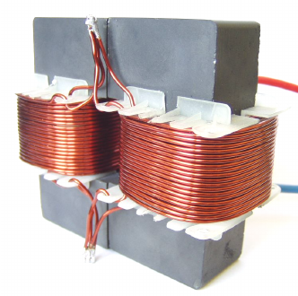
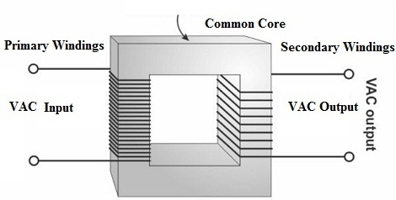
Transformer

Slide 6
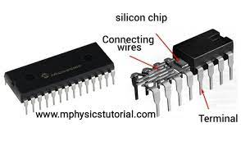
Integrated Circuits
Integrated circuit, another name for a chip, is a small electronic device made out of semiconductor material.
The first IC was developed in the1950s by Jack of Texas Instruments and Robert Noyce of Fairchild Semiconductor.
ICs are used for a variety of devices, including microprocessors, audio and video equipment, automobiles, and other home appliances.
Integrated circuits are made up of several components such as R, C, L, diodes and transistors. They are built on a small single block or chip of a semiconductor known as an integrated circuit (IC). All of them work together to perform a particular task.

Slide 7
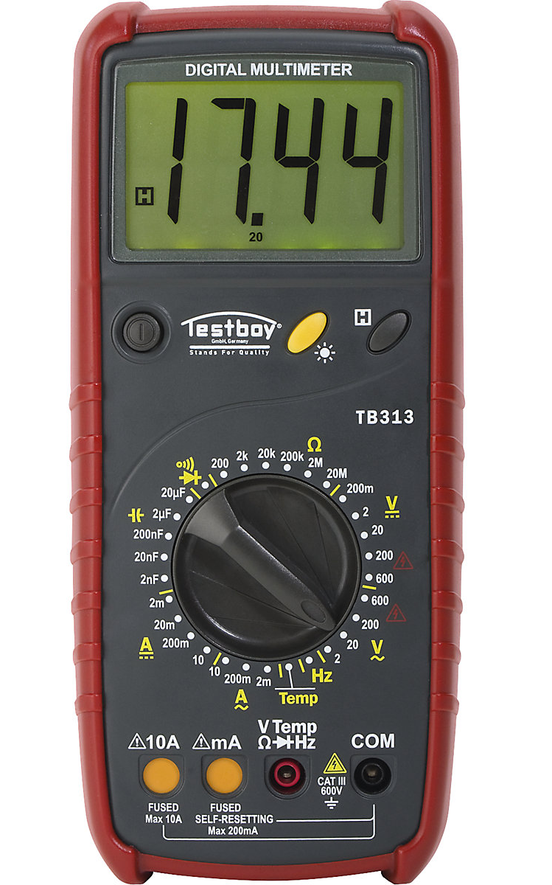
Multimeter/ Ohmmeter
A Multimeter , also known as a Volt-Ohm meter , is an electronic measuring instrument that combines several measurements functions in one unit.

Slide 8
Active Components
The electronics components which are capable of amplifying or processing an electrical signal are called as passive component.
Examples:
Transistors
Logic Gates

Slide 9
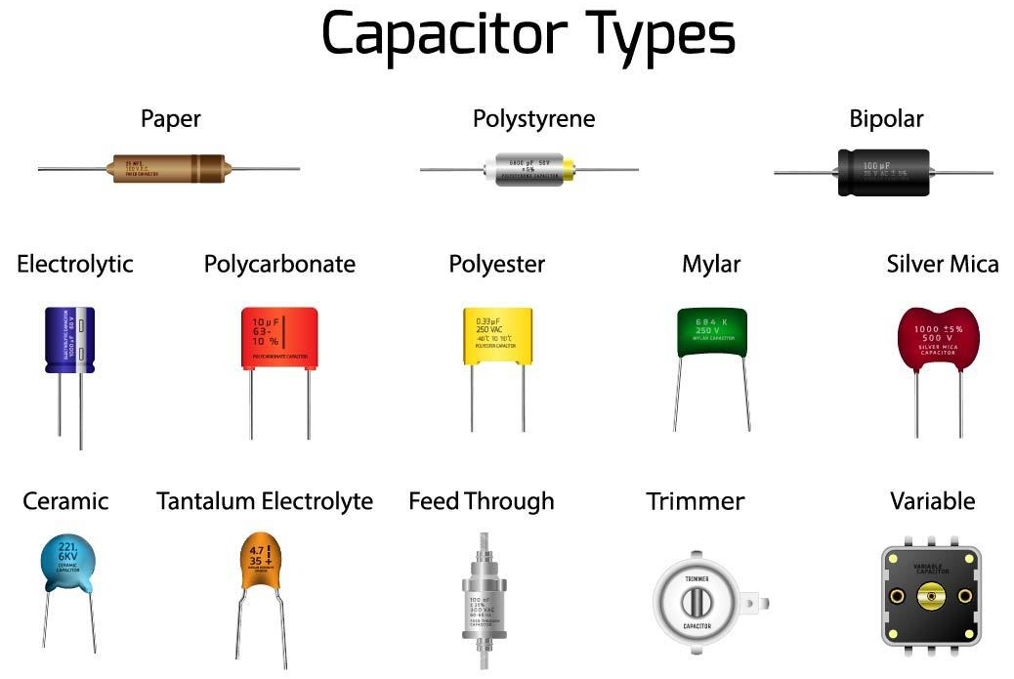
Capacitor
Capacitor is a passive two-terminal electrical component used to store electrical energy temporarily in an electric field.
Capacitors come in several different varieties, the two most common being ceramic disk and electrolytic. The amount of capacitance of a given capacitor is usually measured in microfarads , abbreviated μF.

Slide 11
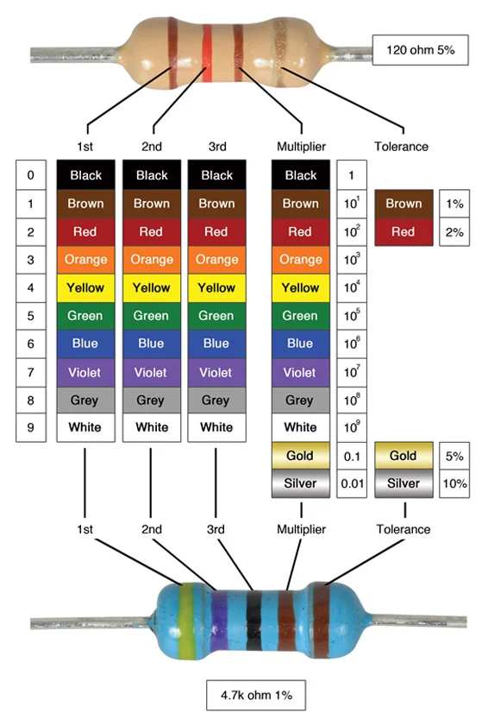
Resistor

Slide 12
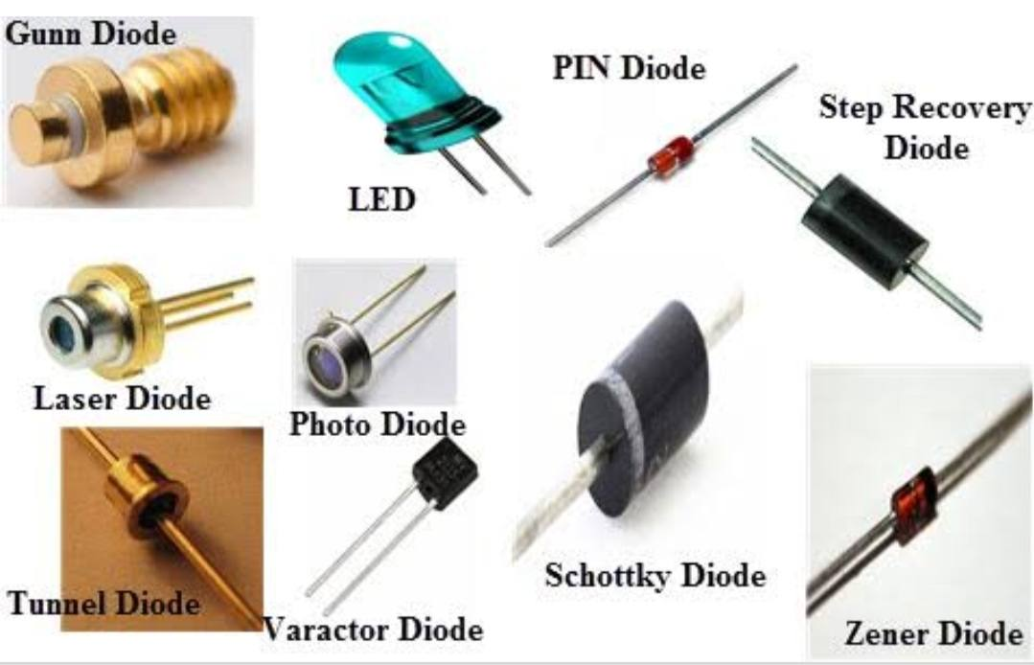
Diode
Diode is a two terminal electronic component with asymmetric conductance; it has low resistance to current in one direction , and high resistance in the other.
The most common function of a diode is to allow an electric current to past in one direction, while blocking current in the opposite direction.

Slide 13
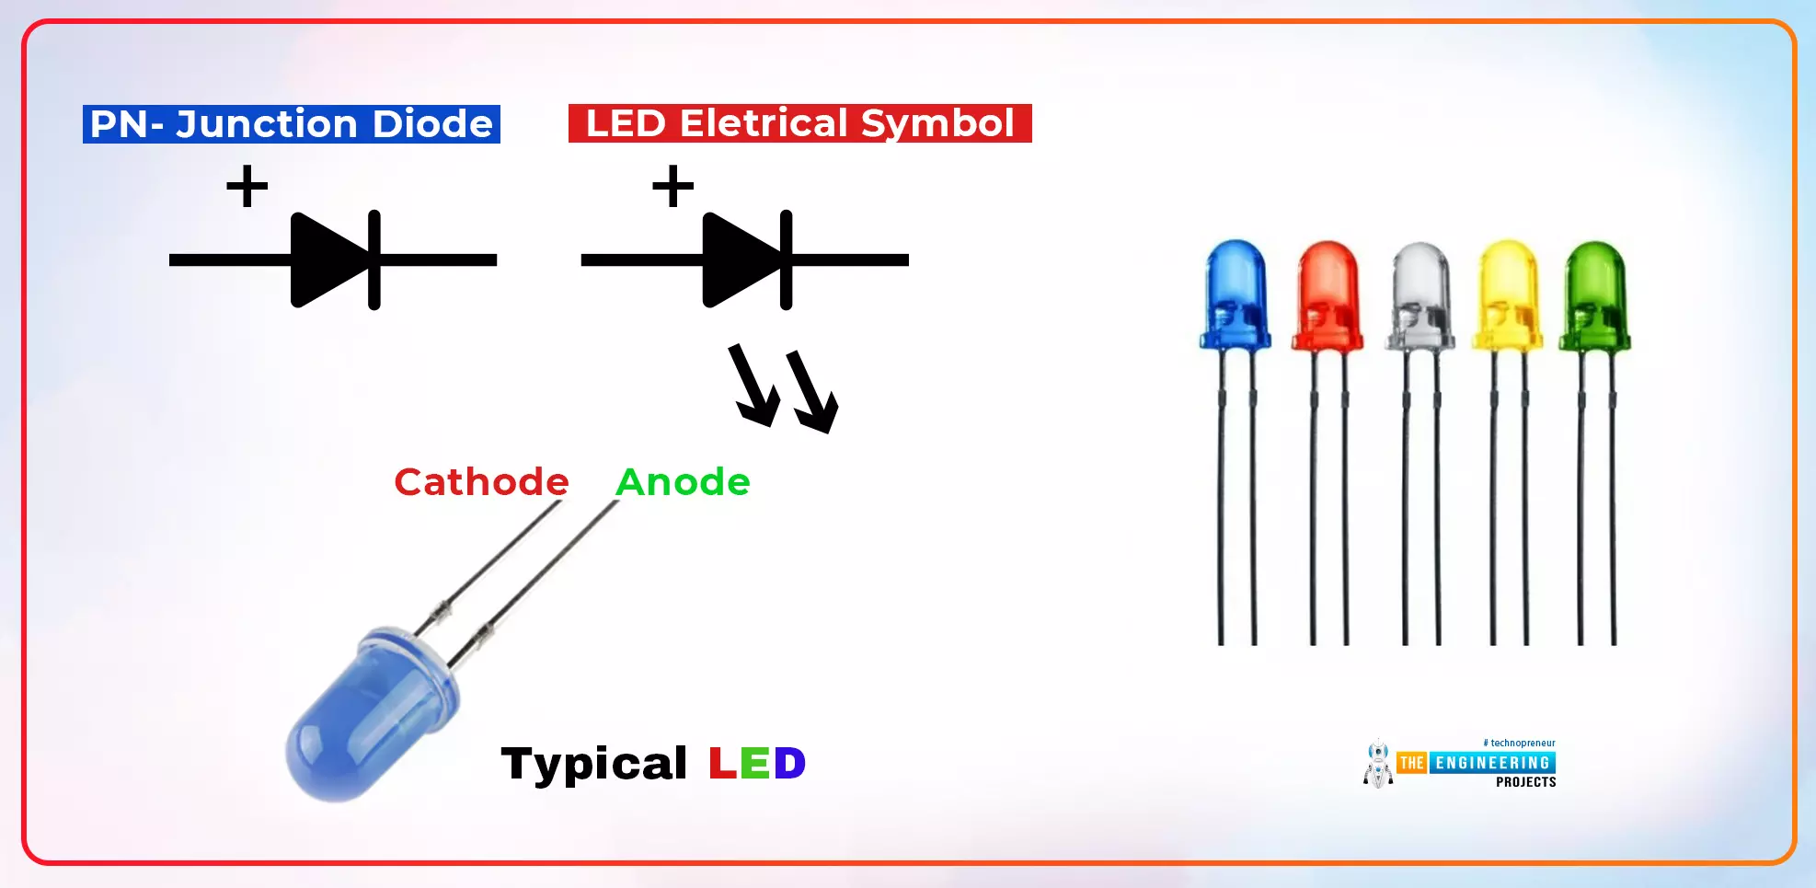
Light Emitting Diodes

Slide 14
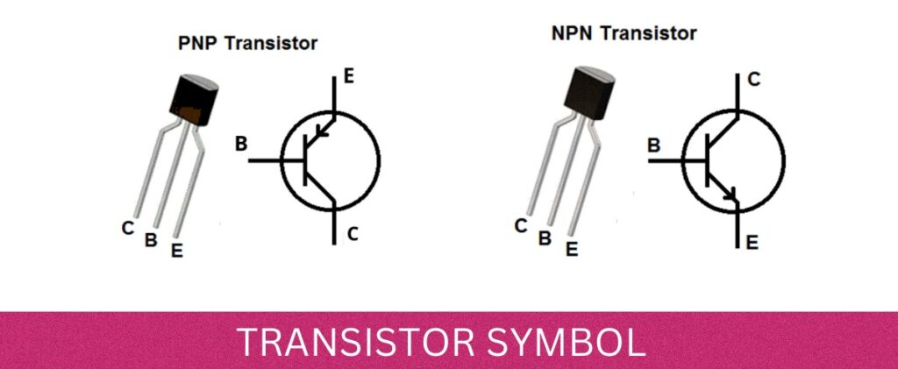
Transistor
Transistor is a semiconductor device used to simplify and switch electronic signals and electrical power. It is composed of semiconductor material with at least three terminals for connection to an external circuit.

Slide 15
Semi conductors
A semiconductor is a material which has an electrical conductivity value falling between that of a conductor, such as copper, and an insulator, such as glass.
Materials such as silicon and germanium , have electrical properties somewhere in the middle , between those of a “Conductor” and an “Insulator”. They are not good conductors nor good insulators.

Slide 16
Conductors
The materials that have a low value of resistivity allowing them to easily pass an electrical current due to there being plenty of free electrons floating about within their basic atom structure.
Ex: Copper, Aluminium
Insulators:
on the other hand are the exact opposite of conductors. They are made of materials , generally non-metals, that have very few or no “free electrons” floating about within their basic atom structure because the electrons in the outer valence shell are strongly attracted by the positively charged inner nucleus.
Ex: marble, fused quartz, PVC , plastics, rubber etc.

Slide 17
Amplifier
An amplifier, electronic amplifier or (informally) amp is an electronic device that can increase the magnitude of a signal (a time-varying voltage or current).
It is a two-port electronic circuit that uses electric power from a power supply to increase the amplitude (magnitude of the voltage or current) of a signal applied to its input terminals, producing a proportionally greater amplitude signal at its output.
The amount of amplification provided by an amplifier is measured by its gain: the ratio of output voltage, current, or power to input.
An amplifier is defined as a circuit that has a power gain greater than one.

Slide 18
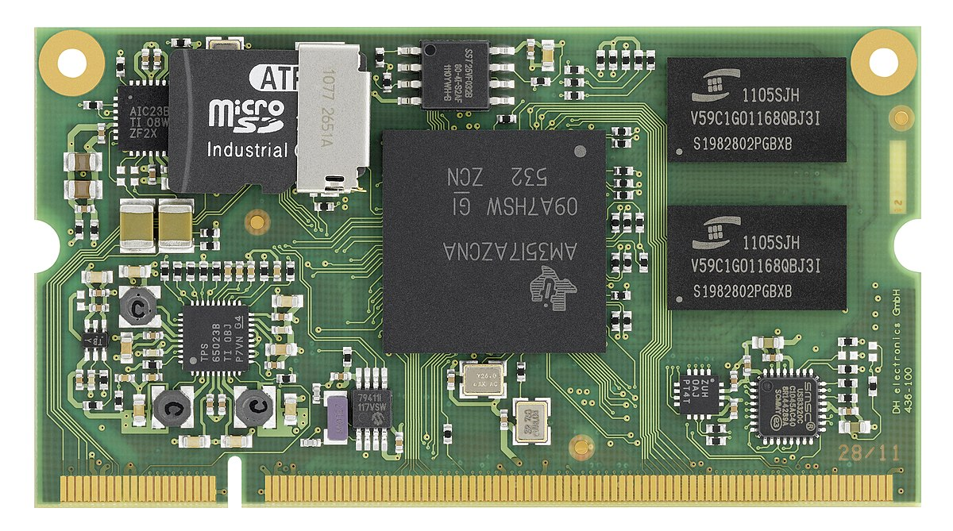
Oscillator : An oscillator is a mechanical or electronic device that works on the principles of oscillation: a periodic fluctuation between two things based on changes in energy.
Computers, clocks, watches, radios, and metal detectors are among the many devices that use oscillators.
An embedded system is a combination of computer hardware and software designed for a specific function.
Embedded systems may also function within a larger system. The systems can be programmable or have a fixed functionality.

Slide 19
Electronic communication is any form of communication that's broadcast, transmitted, stored or viewed using electronic media, such as computers, phones, email and video. But each has specific uses and is better suited for certain scenarios.
A sensor is a device that produces an output signal for the purpose of sensing a physical phenomenon.
In the broadest definition, a sensor is a device, module, machine, or subsystem that detects events or changes in its environment and sends the information to other electronics, frequently a computer processor.
Sensors are always used with other electronics.

Slide 20
Application of Electronics
Communication and Entertainment
Industrial
Medical Science
Defence

Slide 21
Syllabus
Module 1 : Power Supplies –Block diagram, Half-wave rectifier, Full-wave rectifiers and filters, Voltage regulators, Output resistance and voltage regulation, Voltage multipliers.
Amplifiers – Types of amplifiers, Gain, Input and output resistance, Frequency response, Bandwidth, Phase shift, Negative feedback, multi-stage amplifiers .
Module 2: Oscillators – Barkhausen criterion, sinusoidal and non-sinusoidal oscillators, Ladder network oscillator, Wein bridge oscillator, Multivibrators, Single-stage astable oscillator, Crystal controlled oscillators (Only Concepts, working, and waveforms. No mathematical derivations) Operational amplifiers -Operational amplifier parameters, Operational amplifier characteristics, Operational amplifier configurations, Operational amplifier circuits.

Slide 22
Module 3: Boolean Algebra and Logic Circuits: Binary numbers, Number Base Conversion, octal & Hexa Decimal Numbers, Complements, Basic definitions, Axiomatic Definition of Boolean Algebra, Basic Theorems and Properties of Boolean Algebra, Boolean Functions, Canonical and Standard Forms, Other Logic Operations, Digital Logic Gates.
Combinational logic: Introduction, Design procedure, Adders- Half adder, Full adder.
Module 4: Embedded Systems – Definition, Embedded systems vs general computing systems, Classification of Embedded Systems, Major application areas of Embedded Systems, Elements of an Embedded System, Core of the Embedded System, Microprocessor vs Microcontroller, RISC vs CISC Sensors and Interfacing – Instrumentation and control systems, Transducers, Sensors, Actuators, LED, 7-Segment LED Display.

Slide 23
Module 5: Analog Communication Schemes – Modern communication system scheme, Information source, and input transducer, Transmitter, Channel or Medium – Hardwired and Soft wired, Noise, Receiver, Multiplexing, Types of communication systems. Types of modulation (only concepts) – AM , FM, Concept of Radio wave propagation (Ground, space, sky)
Digital Modulation Schemes: Advantages of digital communication over analog communication, ASK, FSK, PSK, Radio signal transmission Multiple access techniques.

